Slide 1

Hotspots Analysis of Malaria Prevalence.
(use case: Nigeria)
CAPSTONE PROJECT
ON
Geospatial and Machine Learning
Approach
Writing by: Samuel Ekong (Geospatial Data Science)
GDS_FE/23/89939683

Slide 2

Abstract
This project explores malaria prevalence in Nigeria integrating Geospatial data, Demographic, and Machine Learning insights to inform targeted interventions and resource allocation. Built classification models to predict risk categories, support evidence-based decision-making for malaria control strategies in Nigeria.

Slide 3

Introduction
Malaria is a pressing public health challenge in Nigeria, driven by climate and demographic factors which leads to certain regions experiencing disproportionately high prevalence rates, underscoring the need for targeted and data-driven approach to effectively control and eliminate this disease.

Slide 4
Aim & Objectives
To identify hotspots, analyze malaria prevalence and correlatted variables across Nigeria, leveraging geospatial insights to inform targeted interventions and resource allocation.
To map high risk areas, factors contributing to malaria transmission, seeks to support evidence-based decision-making for malaria control strategies in Nigeria.

Slide 5
Methodology
This project will employ a retrospective spatial analysis of malaria survey data.
Data collection, Preprocessing, Exploratory/Spatial Data Analysis combining it with environmental, demographic to identify hotspots.
Model build to accurately predict statistically significant cases of malaria prevalence among other variables.

Slide 6

Analysis and Techniques
The Analysis involve spatial regression models to examine the relationships between malaria prevalence and potential risk factors.
Hotspot segmentation, different mapping and visualization at the state level allows policymakers to prioritize interventions effectively.
Techniques such as spatial interpolation and hotspot analysis applied to visualize and quantify the distribution of malaria cases.
Histogram of prevalence values.
Boxplots showing variability among states
Analysis
Techniques

Slide 7
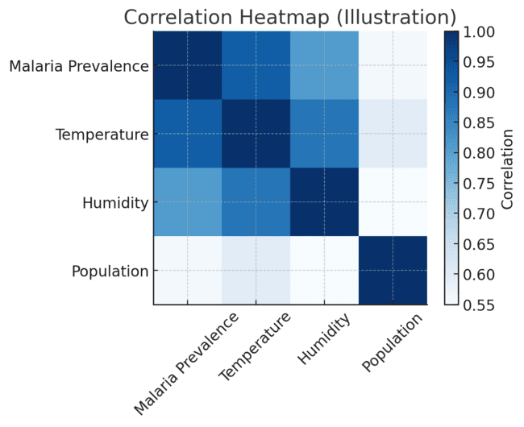
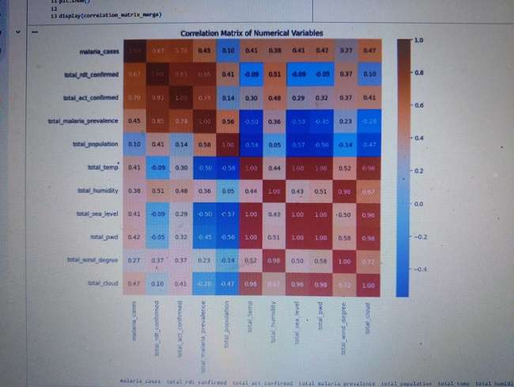
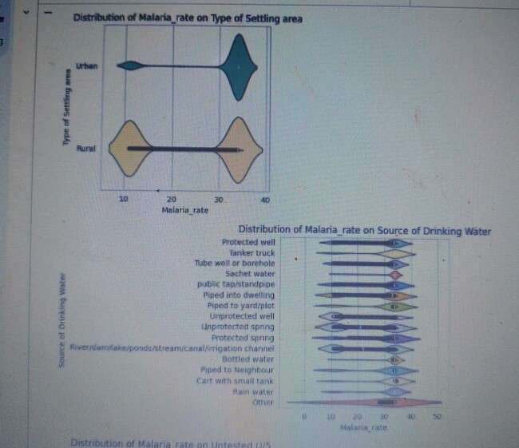
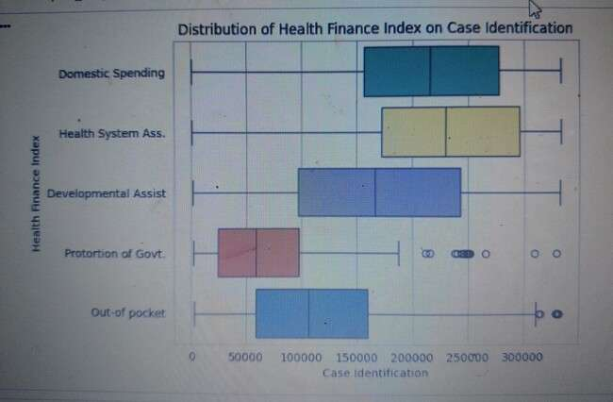
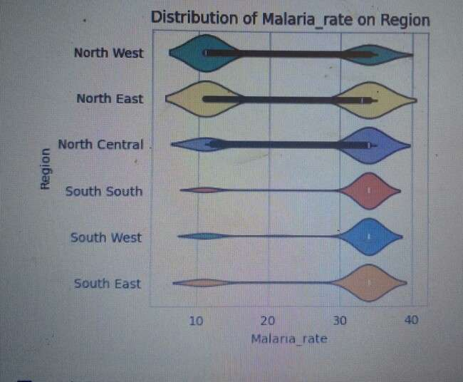
Correlation Heatmap
Illustration of malaria prevalence correlation with environmental and demographic factors.
Malaria prevalence strongly correlates with temperature (0.92), humidity (0.81), precipitation (0.95)… etc.
Correlation matrices between environmental factor and malaria load
Visualizing Distribution Plot

Slide 8
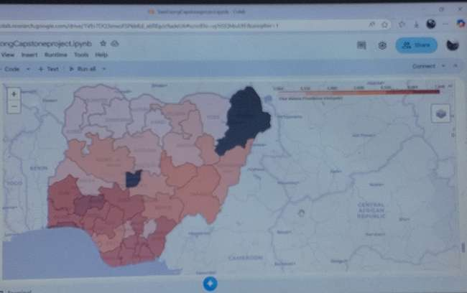
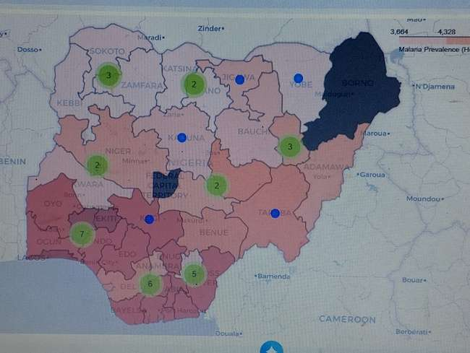
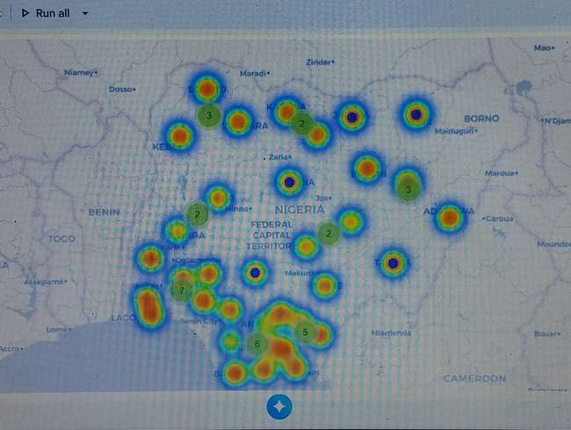
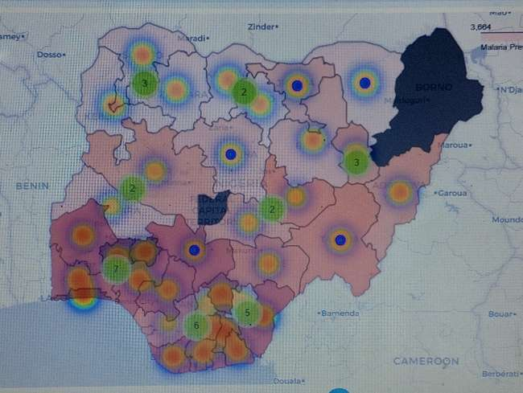
Thematic Map
Using Folium/Leafmap interactive choropleth and heatmap to visualize malaria prevalence across Nigeria.
Cluster circle marker(Malaria cases per state)
Choropleth hotspots (total malaria prevalence by state).
Heatmap overlay (Density of malaria cases across Nigeria).

Slide 9

Discussion
The strong correlation between malaria prevalence and climatic factors aligns with existing literature on malaria ecology. Warm, humid environments foster mosquito breeding and parasite development. The negative relationship with sea level suggests that low-lying areas are more prone to malaria transmission. Population density amplifies malaria risk, as urban centers may experience higher exposure rates despite varying levels of intervention there is a performance improvements observed across the models after fine-tuning and scaling, Identifying the best-performing model based on the evaluation metrics and that leads the discuss for the significance of the results for malaria prevalence hotspot analysis. Also suggesting any potential next steps for further model enhancement or real-world deployment.

Slide 10

Result Findings
Correlation Among Malaria Indicators:
  Malaria prevalence correlated with RDT confirmation (0.56) and ACT confirmation (0.45).
  State-level aggregated malaria prevalence strongly correlated with mean RDT (0.80) and ACT (0.66).
Environmental Factors:
  Malaria prevalence strongly correlated with:
    Temperature (0.92)
    Humidity (0.81)
    Precipitation/Weather degree (0.95)
    Cloud coverage (0.90)
  Negative correlation with sea level (-0.97).
Population Factors:
  Population size moderately correlated with malaria prevalence (0.56) and environmental variables.
Spatial Distribution:
  Choropleth maps showed malaria prevalence concentrated in states with high humidity, temperature, and dense population clusters

Slide 11

Conclusion and Recommendation
Conclusion: This project demonstrate the following that;
Malaria prevalence in Nigeria is influenced by environmental and demographic conditions .
Targeted interventions in hotspot states, through the use of predictive risk modeling, and integrating multi-sectoral strategies.
This comparative analysis confirmed XGBoost as the top-performing model in terms of overall accuracy and balanced performance, making it the most suitable for detecting malaria prevalence hotspots.
Recommendations:
Target malaria control programs in states with high climatic suitability for malaria transmission. (High-risk state require targeted interventions (bed nets, IRS spraying, awareness)).
Deploy geospatial risk maps to guide national malaria elimination campaigns.
Integrate machine learning models for predictive risk assessment to support early warning systems.
Encourage multi-sectoral approaches combining health, environmental, and urban planning data

Slide 12
Dataset Resource Reference
National Malaria Elimination Programme (NMEP), World Health Organization Surveillance datasets, Nigeria Open Disease & Health Data.
Nigeria Malaria Indicator Survey, DHS Program.
WorldPop Hub. Grid3_Admin Boundary (NGA_State_Boundaries), Nigeria Malaria Survey (NMIS) from Ministry of Health, Nigeria Cities Weather Data by GeoBoundaries data provided under the Creative Commons Attribution 4.0 International (CC BY 4.0) license (https://www.geoboundaries.org/).
(https://data.humdata.org)
( https://pmc.ncbi.nlm.nih.gov).
(https://www.geoboundaries.org).

